Slide 1
Bayesian Networks NRES 746: Advanced Analysis Methods in Natural Resources and Environmental Science Fall 2016 Dr. Kevin Shoemaker
Tim Caldwell, James Simmons, 10/17/2016

Slide 2
What are we going to talk about?
History
Quick review of SEM/Relationship to SEM
Theory
R example
Highlights/Opportunities
Current Status, Future, and Resources
Discussion

Slide 3
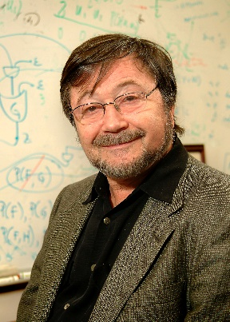

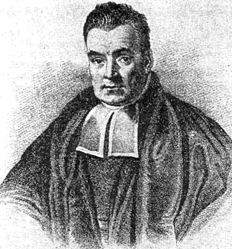
Back in the day….
Concept coined by Judea Pearl in 1985
Initially emerged from artificial intelligence
It’s a way of machine learning – updating beliefs.
Called Bayes because
Input or starting information can be subjective
Uses Bayes Rule to update model information
Distinguishes between causal and evidential modes

Slide 4
A.K.A……
belief networks,
Bayesian belief networks,
Bayes nets,
causal probabilistic networks
Influence diagrams

Slide 5
Bayes Nets in Natural Resources
Adaptive Management
Risk assessment/decision making
Population viability
Environmental/habitat modeling

Slide 6
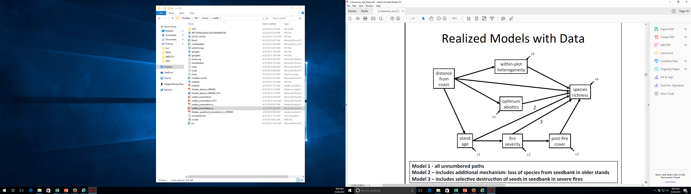
Review of Structural Equation Modeling
What is SEM
Identifying causal relationships (direct and in-direct) with multiple variables.
Path analysis – All measured variables
Endogenous Variable
Exogenous Variable
Grace and Keely, 2006

Slide 7
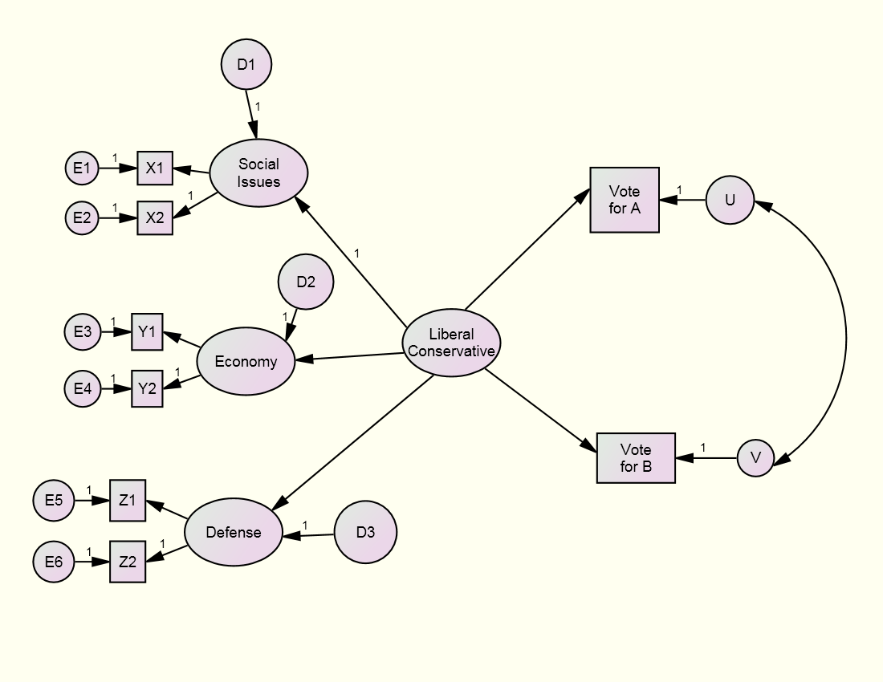
Review of Structural Equation Modeling
What is SEM
Identifying causal relationships (direct and in-direct) with multiple variables.
Latent variables – utilizing measured variables to create an unmeasured variable
Latent Variables
Measured variables
Grace and Keely, 2006

Slide 8
Comparison of Bayesian Networks to SEMs
Dear Jim,
I would not dissuade people from using either causal Bayesian causal networks or structural equation models, because the difference between the two is so minute that it is not worth the dissuasion. The question is only what question you ask yourself when you construct the diagram. If you feel more comfortable asking: What factors determine the value of this variable” then you construct a structural equation model. If on the other hand you prefer to ask: “If I intervene and wiggle this variable, would the probability of the other variable change?” then the outcome would be a causal Bayes network. Rarely do they differ (but see example on page 35 of Causality).
Correspondence between Judea Pearl and Jim Grace, Dec 7 2012. http://causality.cs.ucla.edu/blog/index.php/2012/12/07/on-structural-equations-versus-causal-bayes-networks/
Ok so what is the difference?

Slide 9
Comparison of Bayesian Networks to SEMs
SEM | Bayesian Networks
Cause and effect relationships | Probabilistic causation (occurrence of a cause increasing the probability of an effect)
Not great with non-linear relationships | Deal with non-linear relationships
Latent variable structures | Typically only measured variables
Cannot be trained with new data | New data can be added to train model
Covariance Matrices | Use computation probabilistic distributions at each node
Can describe the data observed | Can infer the probability of an event given certain criteria

Slide 10
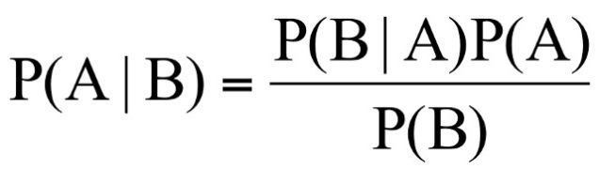
Bayesian Network Theory
Quick Bayes’ Rule Review
P(A) = prior belief in A
P(B) = probability of B
P(B │ A) = Conditional probability of B given A
P(A │ B) = Probability that A occurs given B
Don’t necessarily need “priors” for Bayes nets, but it is how we update our model (more later)

Slide 11
Bayesian Network Theory
Sprinkler example– Two events cause grass to be wet, either we used the sprinklers or it’s raining. But suppose when it rains we typically do not use the sprinkler.
Sprinkler
Rain
First we must assign topology to the network and identify linkages
GrassWet

Slide 12
Bayesian Network Theory
Terminology
Sprinkler
Rain
Parent
Child
GrassWet

Slide 13
Bayesian Network Theory
Terminology
Sprinkler
Rain
Parent
Ancestor
Child
GrassWet

Slide 14
Bayesian Network Theory
Terminology
Root (no parents/ancestors)
Sprinkler
Rain
Leaf (no children/descendents)
GrassWet

Slide 15
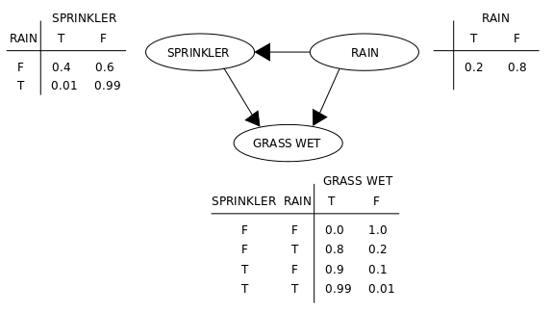
Bayesian Network Theory
Conditional probability tables for each node
Ask questions like “What is the probability that it is raining given the grass is wet?” Basic Inference in a fully defined model (Explaining Away)
This is analyzed using joint probabilities of all parents of the node.

Slide 16
Bayesian Network Theory – Inference/Learning
We can use our network to infer an unknown variable and update our model (this is where we can use Bayes Rule)
For example – If we come out of our house 3 days in a row early in the morning to observe sprinklers on we may now update our model about belief in rain vs sprinklers causing our wet lawn
Structure learning – in simple Bayes nets we may know directionality of all nodes, not the case in a large complex networks. Uses computational algorithms not explained in resources I found.
Known structure, full observability: MLE
Known structure, partial observability: Expected Maximization (EM)
Unknown structure, full observability: Search through model space
Unknown structure, partial observability: EM + search through model space

Slide 17
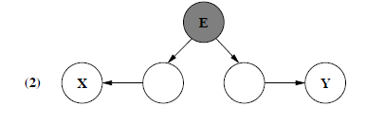

Bayesian Network Theory –Conditional Independence, Markov property, d - separation
Markov property – We generally want this to be true, which is stating that there are no direct dependencies on a causal chain. No backdoor that skips several nodes. But this does not necessarily have to be true.
D – separation – used to determine if the network is conditionally independent by identifying blocking areas.

Slide 18
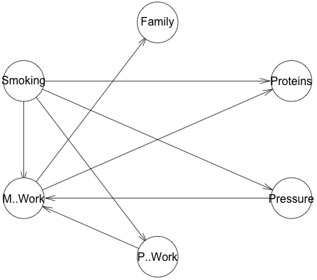
Let’s run through a simple example…
bnlearn package - R
Learn Structure
Train Structure
Inference
Example: https://www.r-bloggers.com/bayesian-network-in-r-introduction/
Coronary Thrombosis
Notes:
After R-blogger site, review quickly the bnlearn link on class site.
Structural learning: Bayesian (start with model) and constraint-based(nothing).

Slide 19
More examples..bnlearn site
http://www.bnlearn.com/

Slide 20
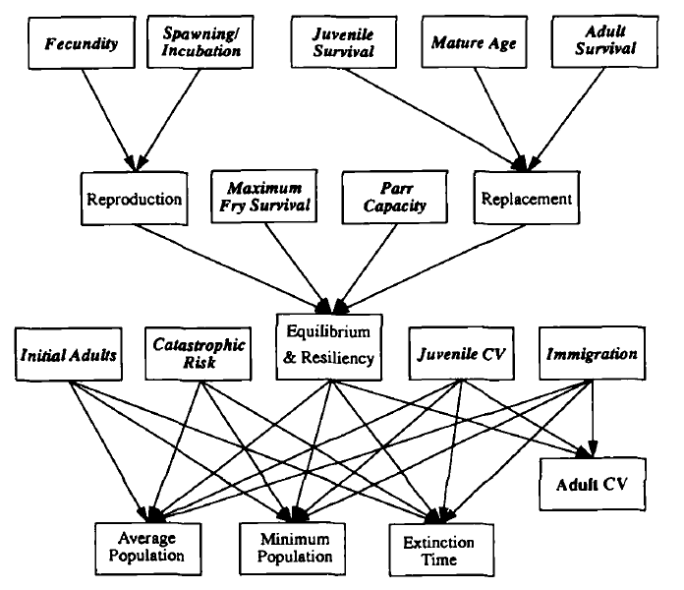
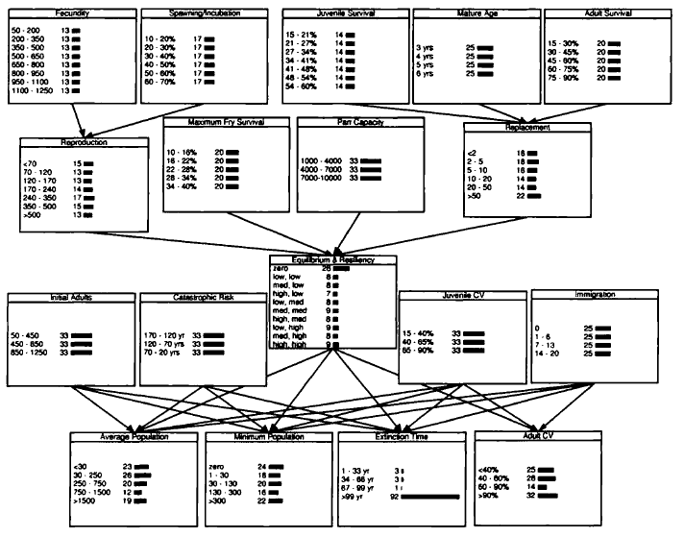
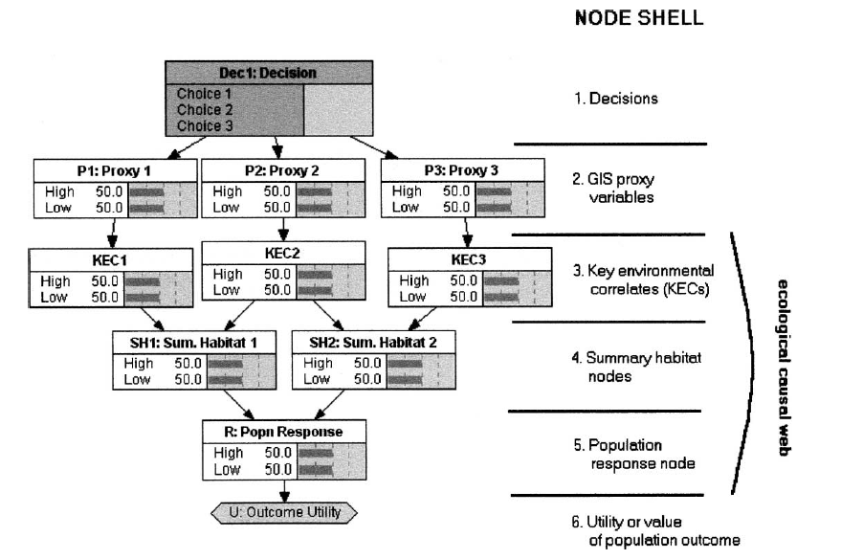
What do BNs look like in literature?
‘Conceptual Model’
‘Bayesian Network’
‘Influence Diagram’
Lee and Rieman 1997
Marcot et. al 2001
Notes:
Conceptual and BN: PVA of salmonids using probabilistic networks.
Influence Diagram: fish and wildlife PVA under different land management alternatives from an EIS

Slide 21
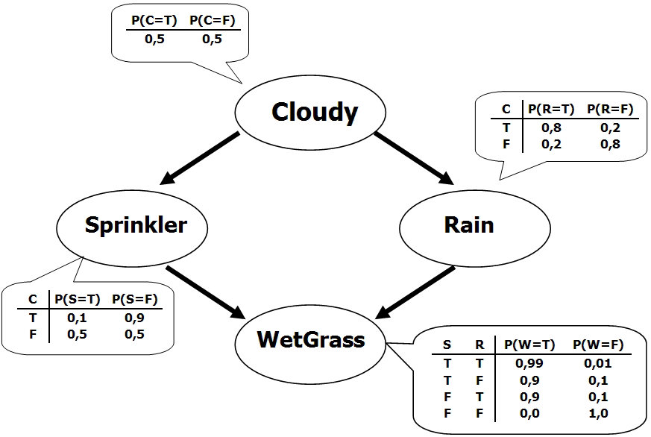
Bayesian Networks are cool because…
Various knowledge sources/types
Small/missing data
Structural learning
Uncertainty/decision analysis
Omni-directional inference
Fast analytical solutions possible
Notes:
Prior info: expert, data, both, and discrete/continuous, can discretize continuous variables

Slide 22
But caveat emptor…..
‘Expert’/prior knowledge
Small data sets/missing data
Discretizing continuous variables
Feedback loops – acyclic (DAG)
Notes:
General pop – overestimate
‘Experts’ - underestimate

Slide 23
When can I use Bayesian Networks?
Anytime you can model a system/process AND
Meet the DAG requirements AND
Satisfactorily address the ‘Opportunities’
Notes:
Quantify – I think can create CPT for a node without data, algorithmns can estimate parameters?

Slide 24








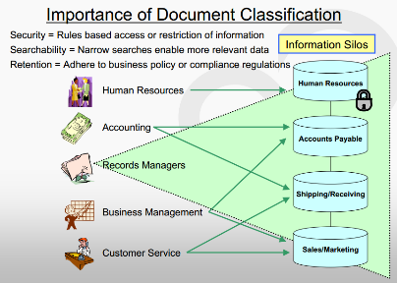
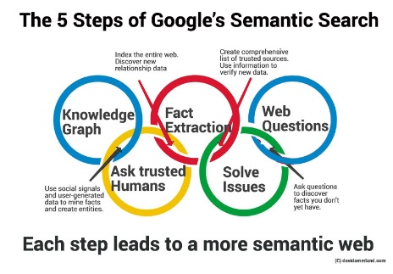
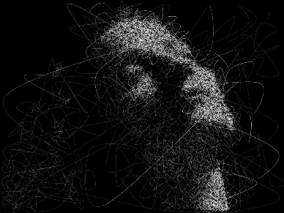
Where is it being used today?
Notes:
Growing – especially in Biology/Ecology fields
Computational biology and bioinformatics (gene regulatory networks, protein structure, gene expression analysis, learning epistasis from GWAS data sets) medicine, biomonitoring, document classification, information retrieval, semantic search, image processing, data fusion, decision support systems, engineering, sports betting, gaming, law, study design and risk analysis. There are texts applying Bayesian networks to bioinformatics and financial and marketing informatics.

Slide 25
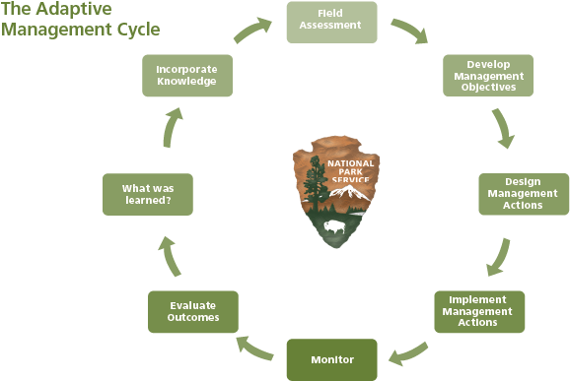
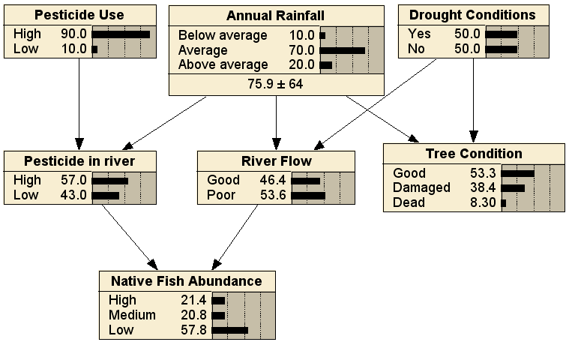
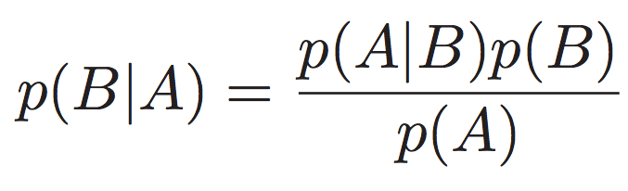
What does the future look like?
Theory
Application

Slide 26
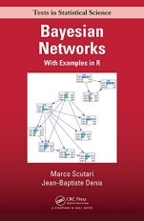
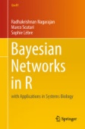
Where can I learn more? - Books
Bayesian Networks: With Examples in R (2014); Marco Scutari, Jean-Baptiste Denis.
Ebook version available via Knowledge Center
Bayesian Networks in R: with Applications in Systems Biology (2013); R. Nagarajan, M. Scutari and S. Lèbre.
Not in library

Slide 27








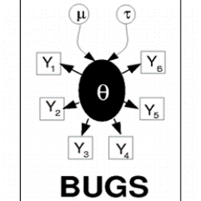
Where can I learn more? – Software/Other
R: bnlearn
Many, many others:
Commercial: Bayesialab, Netica, Hugin, Bayes Server, dVelox, System Modeler, Microsoft
Open-source: Stan, PyMC (Python), SamIam, OpenMarkov, libDAI, OPENBugs, Direct Graphical Models, Graphical Models Toolkit, GeNIe&Smile
Caveat: not all software performs the same functions/have the same features
Other
Youtube! Lots of intro videos and some programming/software examples.

Slide 28
References
L. Uusitalo. Advantages and challenges of Bayesian networks in environmental modelling. 2007. Ecological Modeling (203): 312-318.
T.R. Hammond. A recipe for Bayesian network driven stock assessment. 2004. Can. J. Fish. Aquat. Sci. (61): 1647–1657.
Marcot et al. Using Bayesian belief networks to evaluate fish and wildlife population viability under land management alternatives from an environmental impact assessment. 2001. Forest Ecology and Management (153): 29-42.
Danny C. Lee & Bruce E. Rieman. 1997. Population Viability Assessment of Salmonids by Using Probabilistic Networks. North American Journal of Fisheries Management (17): 1144-1157.
Bayesian Artificial Intelligence, Second Edition. 2010. Kevin B. Korb and Ann E. Nicholson. CRC Press.
B.G. Marcot. 2012. Metrics for evaluating performance and uncertainty of Bayesian network models. Ecological Modeling (230): 50-62.

Slide 29

Discussion

Slide 30
Widescreen Test Pattern (16:9)
Aspect Ratio Test
(Should appear circular)
4x3
16x9

